Slide 1
You Are Not Imagining It
By Keylee Campos, Grace Sadahiro, Razan Karar, and Almaya Wiley-Yancy
Girls Who Code @ Warner Bros. Technology 2018

Slide 2
Why We Chose Microaggressions
We noticed that many people don’t understand what a microaggression is, and how their statement can be viewed as offensive. We hope we can continue the conversation surrounding them.

Slide 3
The Problem
Microaggressions are the building blocks to hate crime and violence against minorities.

Slide 4
Our Project
“You Are Not Imagining It” is a website to educate people about microaggressions and create a platform for people to share their stories.

Slide 5
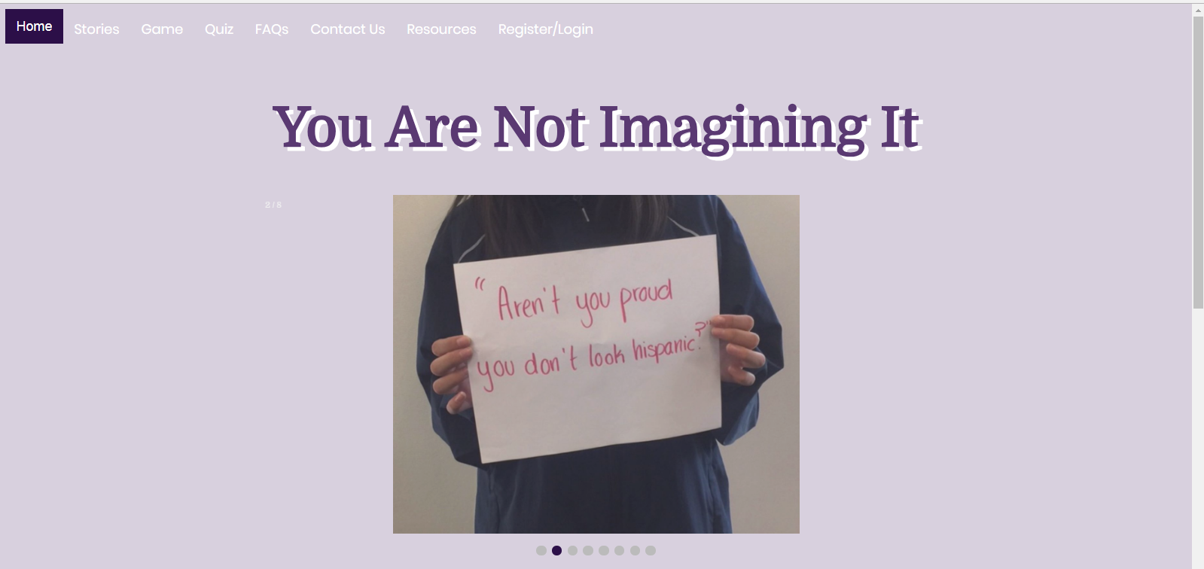
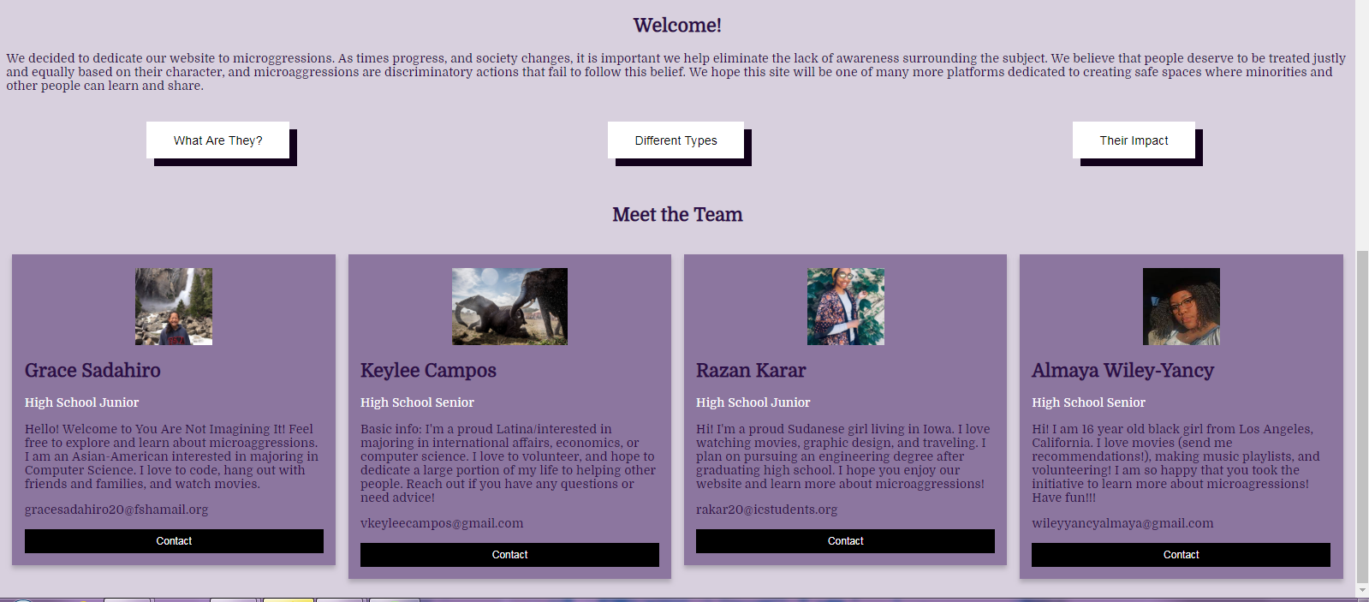
Home Page
Slideshow
Buttons
Meet the team
Notes:
HELLO KHRYSTEIGH

Slide 6
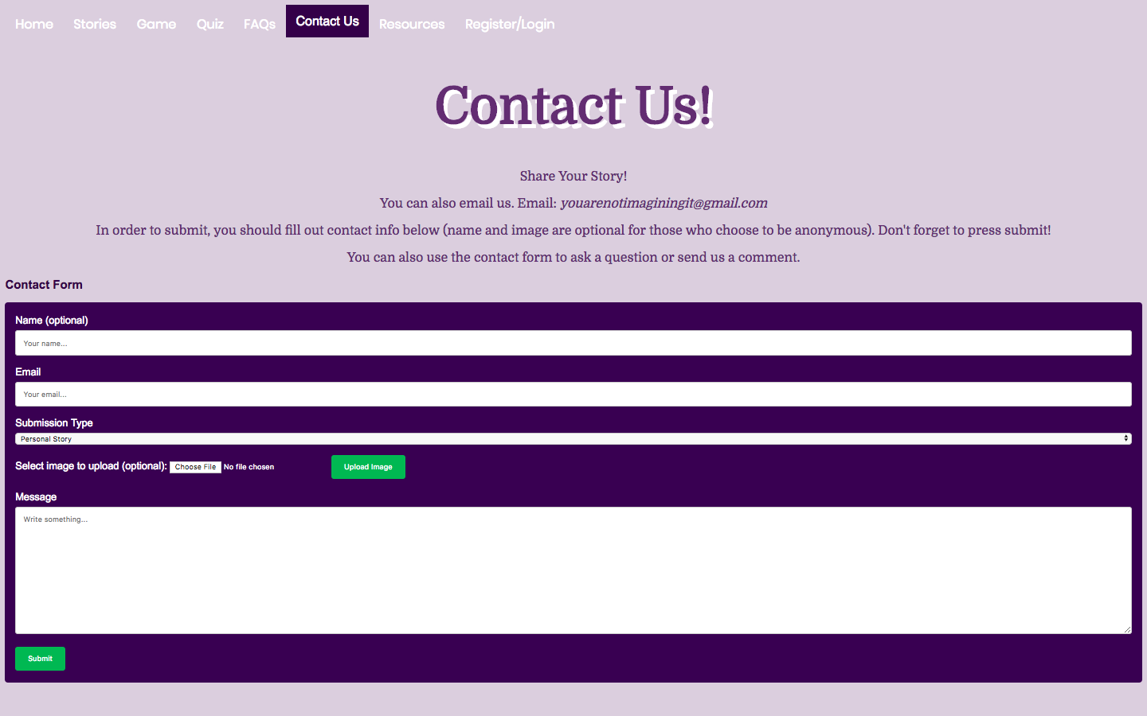
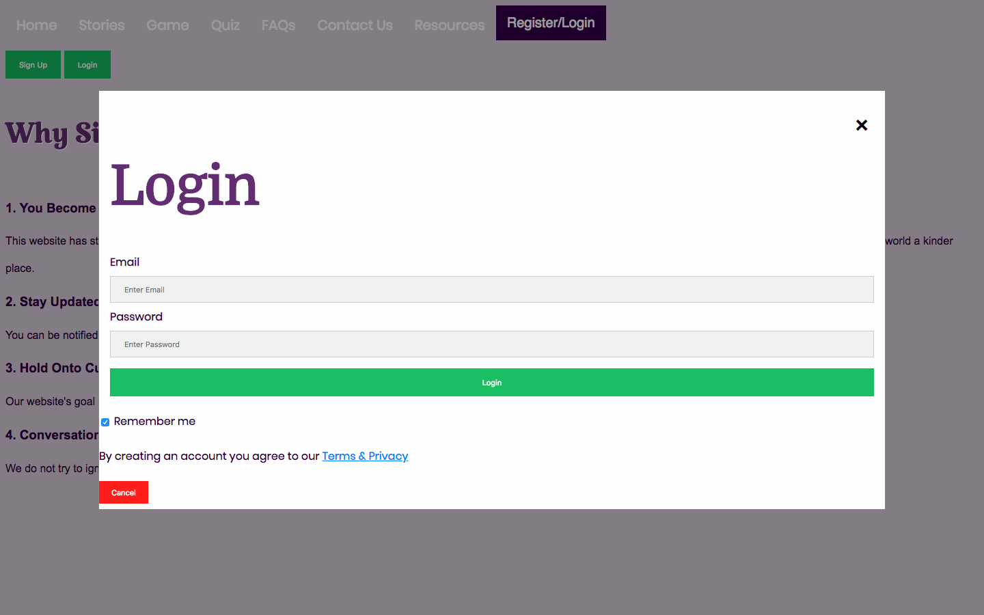
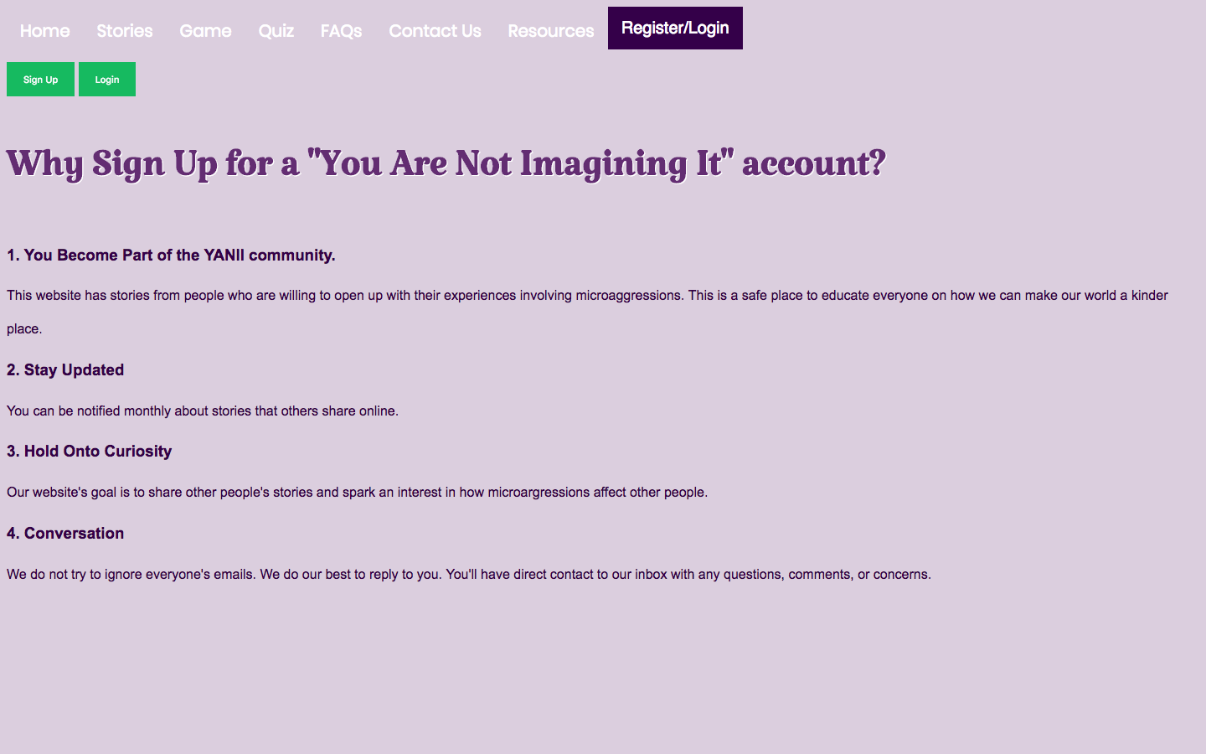
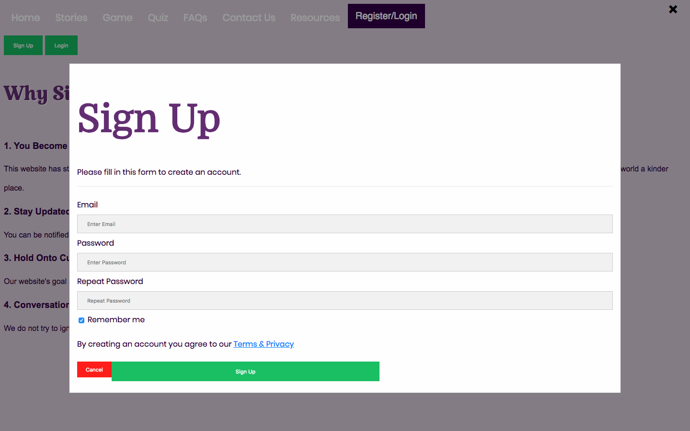
Contact Form
Register/Login
Allows users to connect with us
Modal
Notes:
Contact form: important for us to be responsive and able to improve

Slide 7
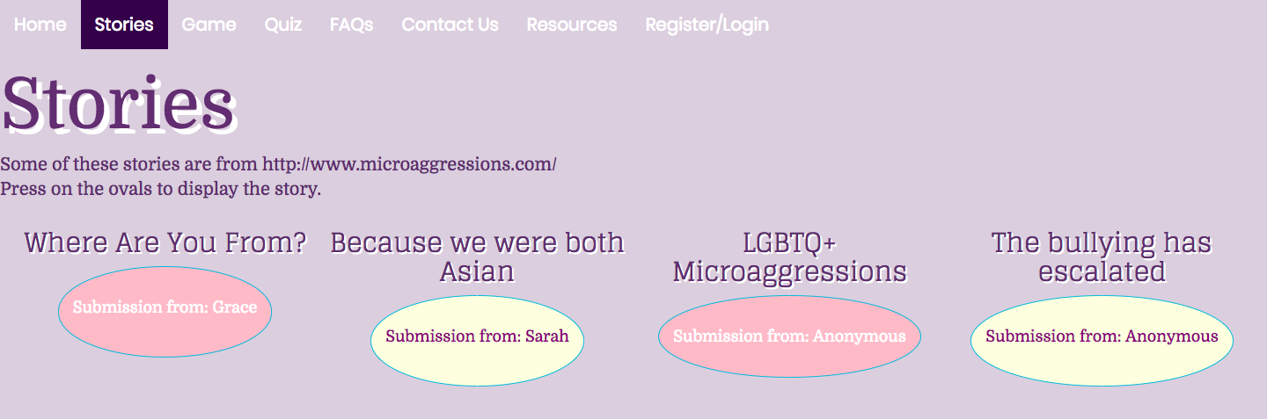
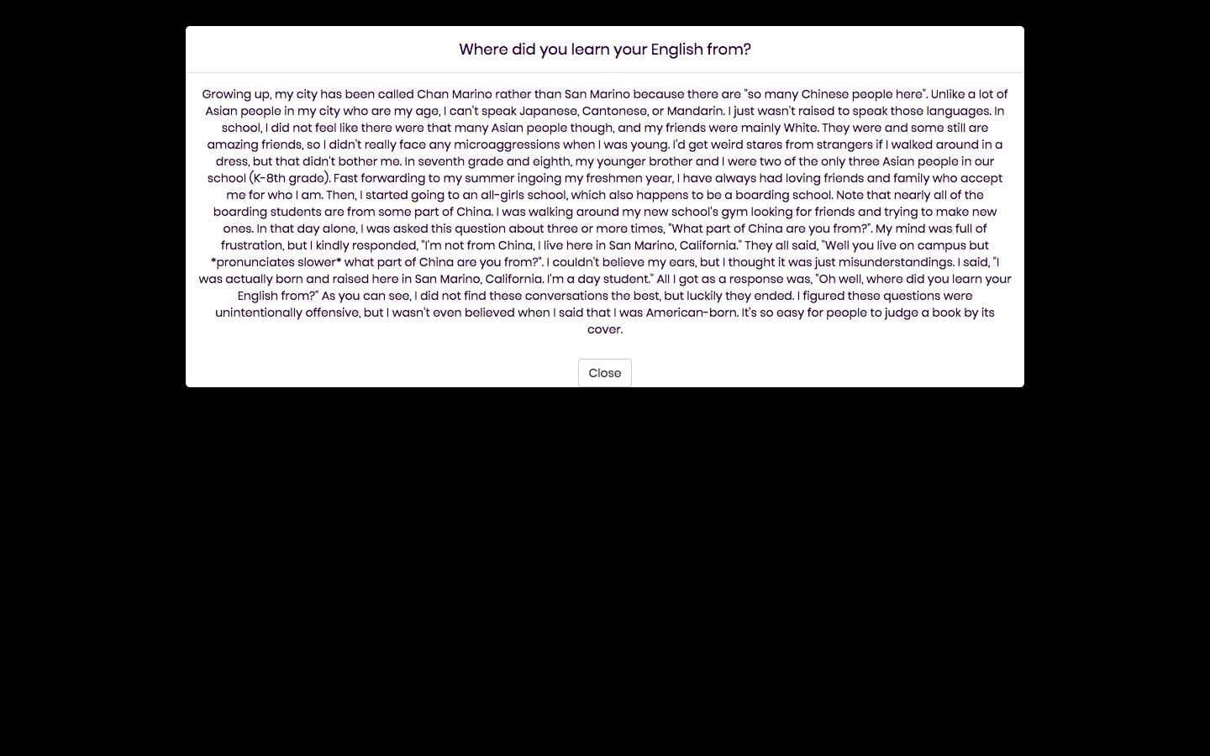
Stories Page
Overview stories page.
Buttons
Expanding text

Slide 8
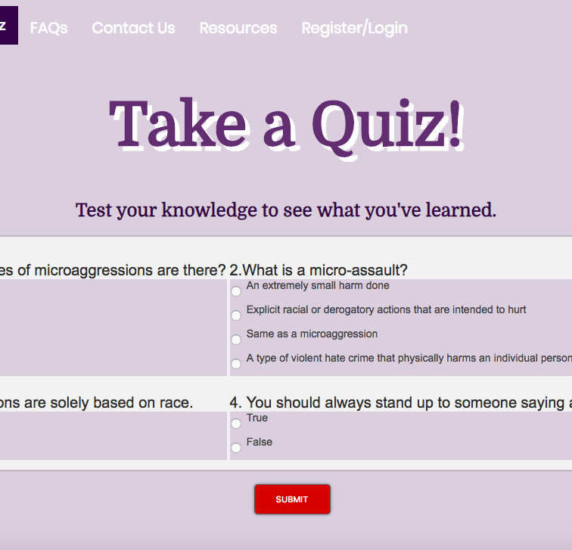
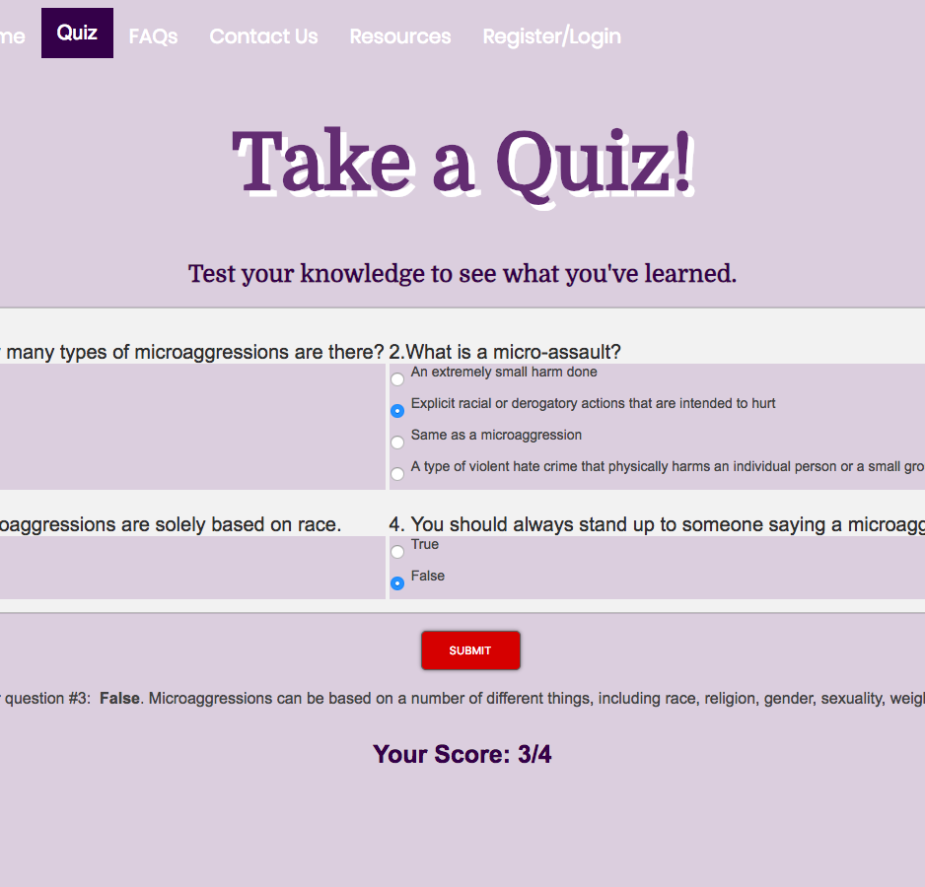
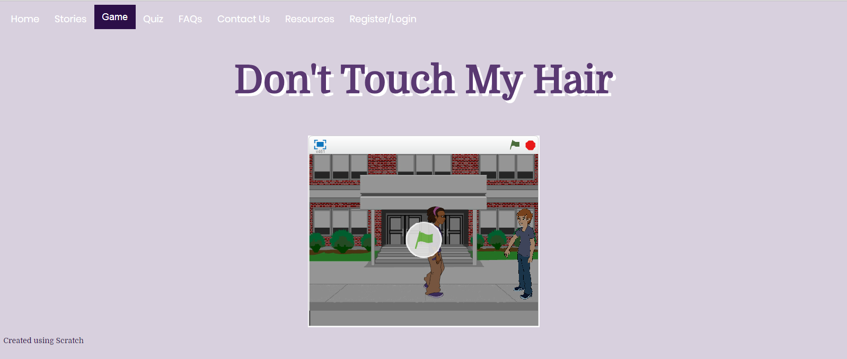
Interactive Content
Quiz
Method to test knowledge
Game
Scratch
Simulation with choices

Slide 9
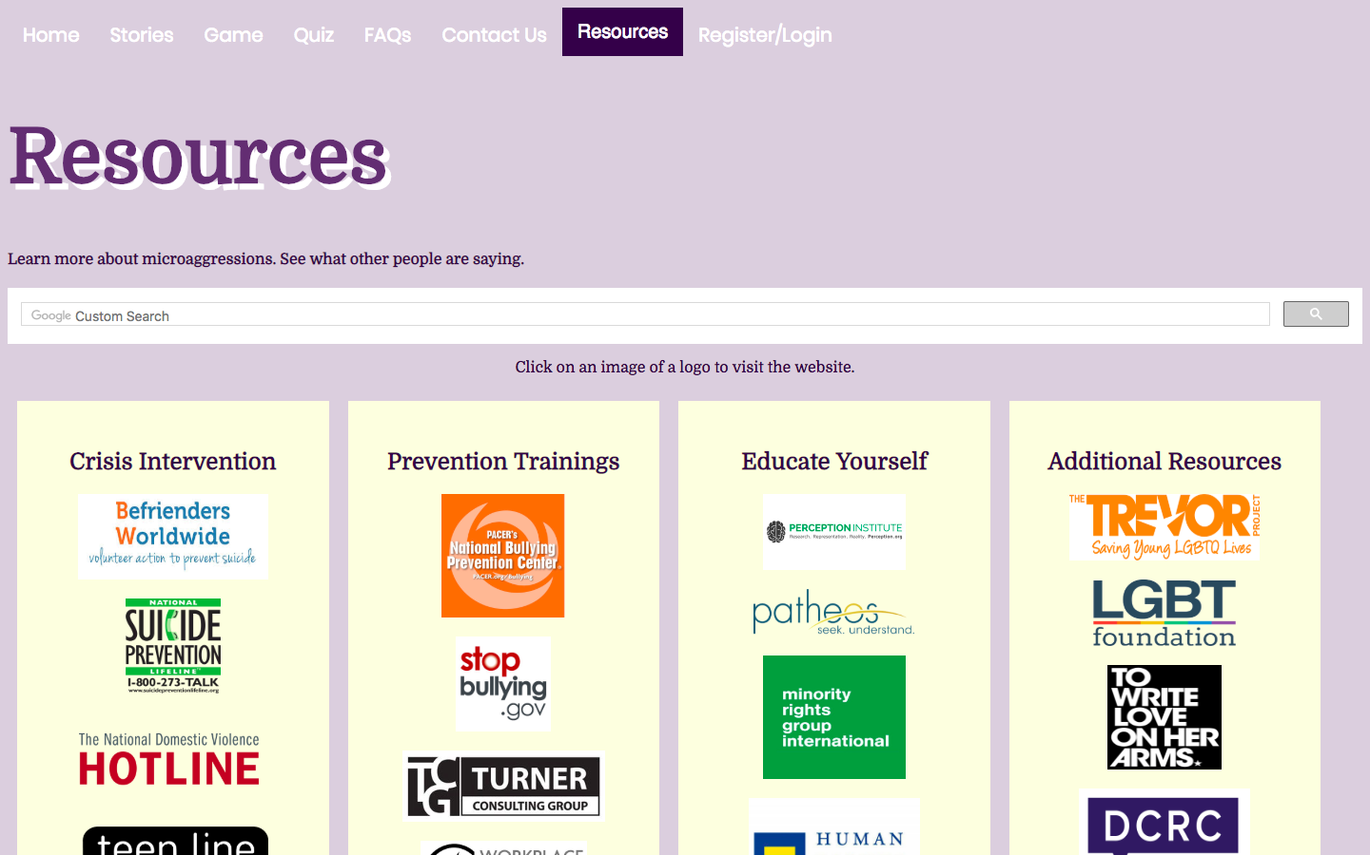
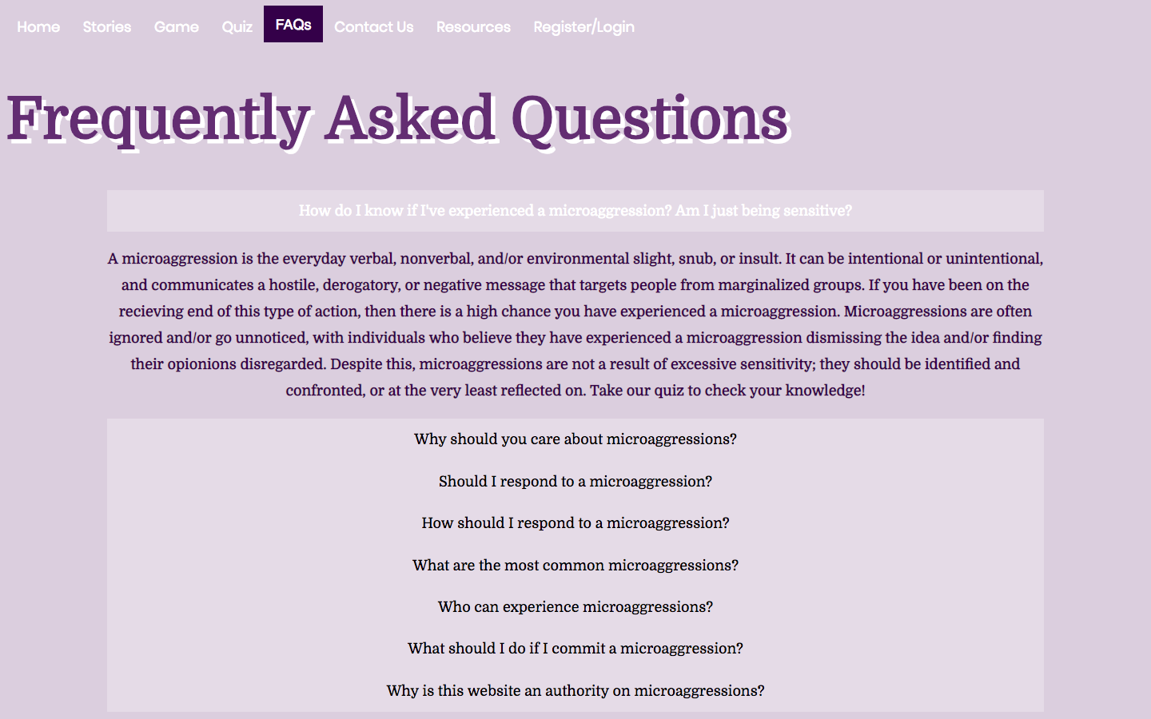
Resources
FAQs
Overview of the FAQs
Research common questions
Answers

Slide 10






Tools
We used:
HTML
CSS
JavaScript
Bootstrap
PHP
Editey
Scratch
PicsArt

Slide 11

What Will We Do Next?
The future of Y.A.N.I.I. :
more web page designing
more page content

Slide 12
Thank You

